Slide 1
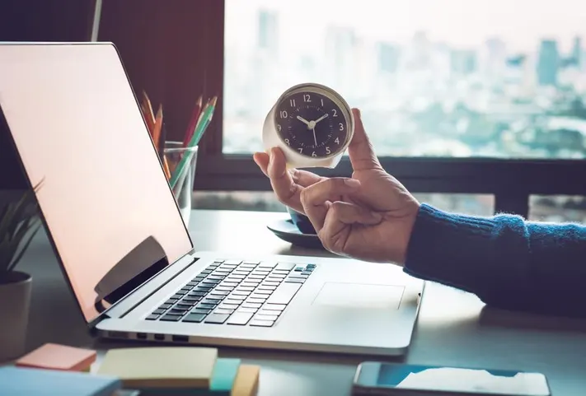
Time Management “Time management is the process of planning and exercising conscious control of time spent on specific activities-especially to increase effectiveness, efficiency, and productivity.”
Sanjeeva Perera - Senior Academic Fellow
Department of Computer Systems Engineering,
Faculty of Computing

Slide 2
Attendance https:

Slide 3
TIME MANAGEMENT

Slide 4
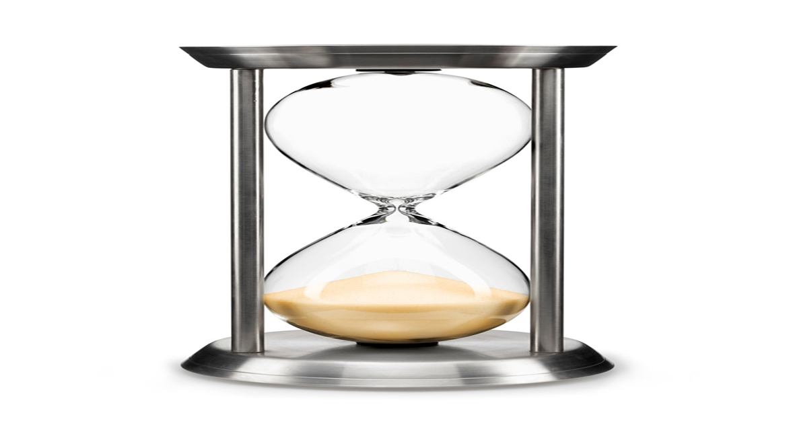
Time Management
Time management is paying attention to how you are spending your most valuable resource (time) and devising a plan to use it more effectively.
Notes:
4

Slide 5
Agenda
Preparation for Time Management
Track Your Time
Tools for Effective Time Management
Notes:
5

Slide 6
Preparation for Time Management
Life Time
Deep Night Time Sleep
Balanced food, Water, Breathing and Exercise
Organized Environment
Mindfulness
Notes:
6

Slide 7
Task 1: Track Your Time
Number of hours of sleep each night __ X 7 = __
Number of grooming (dressing) hours per day __ X 7 = __
Number of hours for meals/snacks per day - include preparation time __ X 7 = __
Total travel time weekdays __ X 5 = __
Total travel time weekends __
Number of hours per week for regularly scheduled functions (clubs, prayers, get-togethers, etc.) __
Number of hours per day for chores (household tasks), errands (shopping), extra grooming, etc. __ X 7 = __
Number of hours of work per week __
Number of hours in class per week __
Number of average hours per week socializing, dates, etc. __
Now add up the totals: __
Subtract the above number from 168: 168 - ___ = ____
Notes:
7

Slide 8
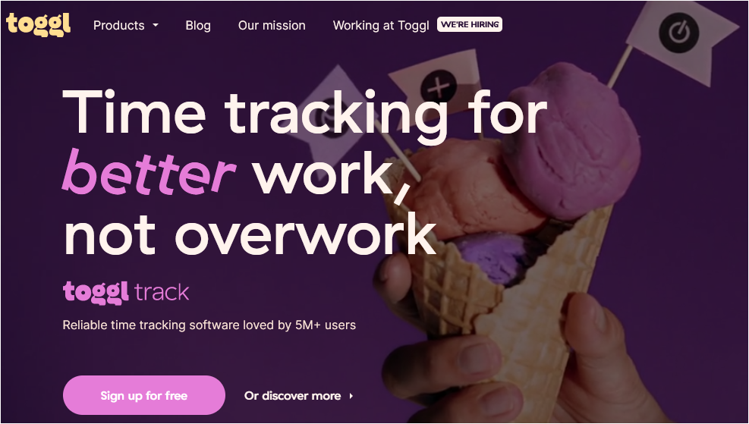
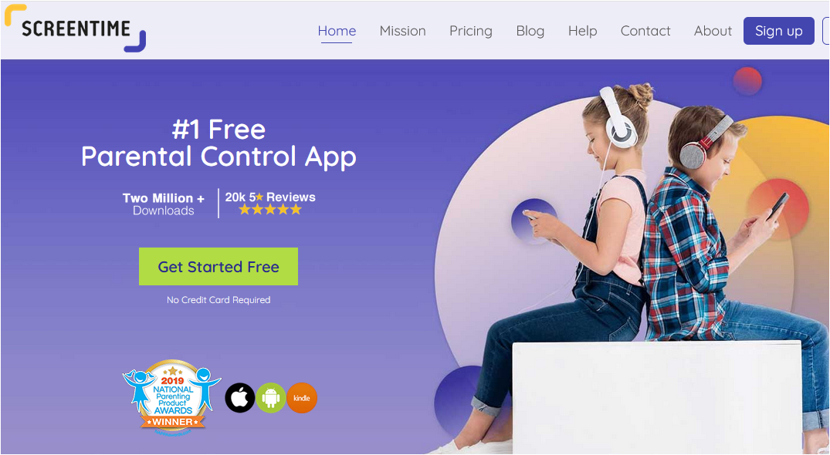
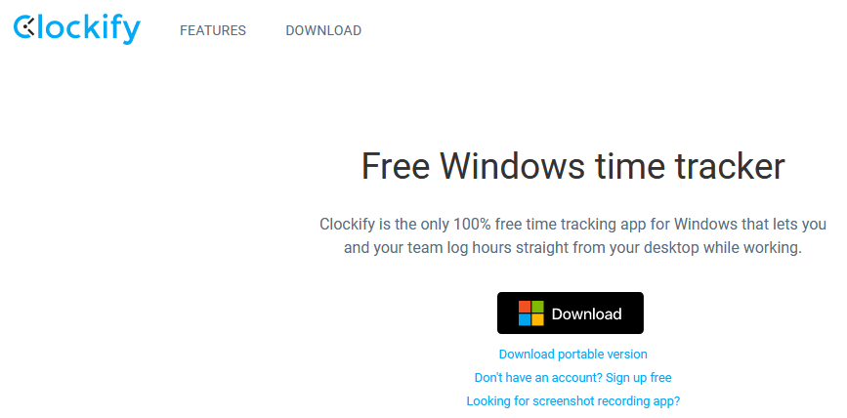
Tools for Effective Time Management
Time Tracking tools
8
Notes:
8

Slide 9
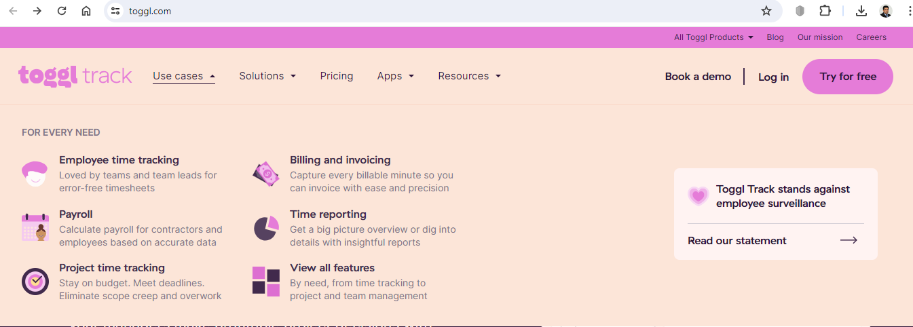
Tools for Effective Time Management
Notes:
9

Slide 10
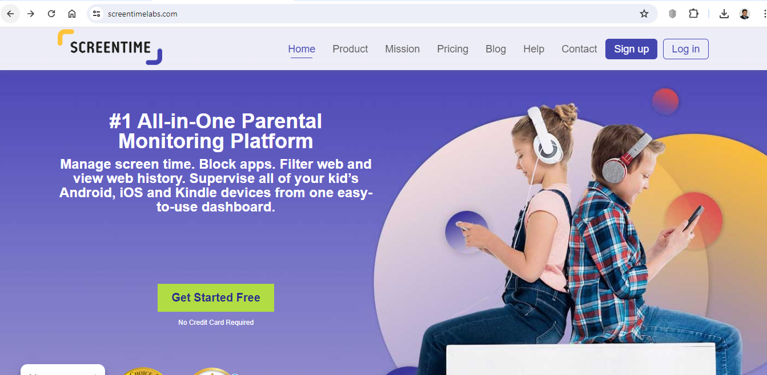
Tools for Effective Time Management
Notes:
10

Slide 11
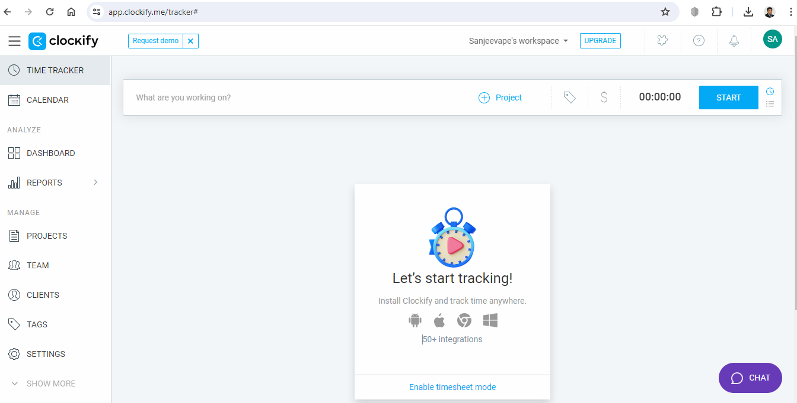
Tools for Effective Time Management
Notes:
11

Slide 12
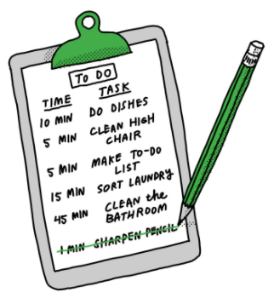
Tools for Effective Time Management
To Do List

Slide 13
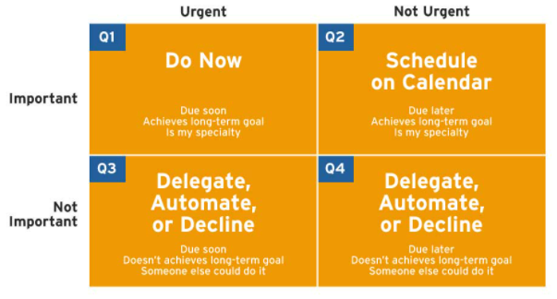
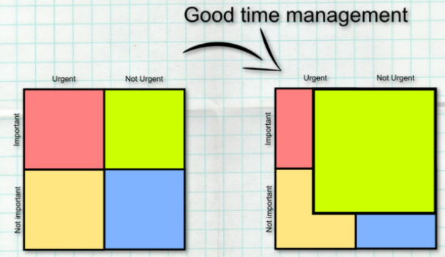
Tools for Effective Time Management
Time Management Matrix

Slide 14
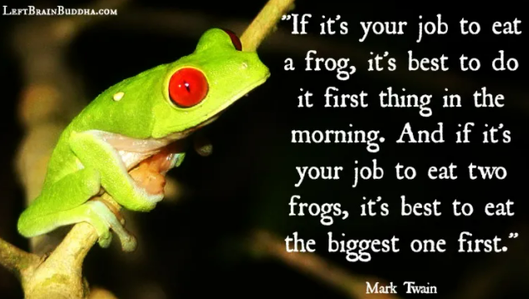
Tools for Effective Time Management
To Do List

Slide 15
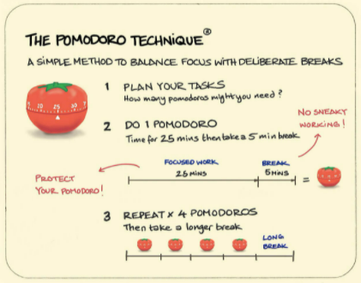
Tools for Effective Time Management
Pomodoro Technique
The Pomodoro Technique is a time management method developed by Francesco Cirillo in the late 1980s. It uses a kitchen timer to break work into intervals, typically 25 minutes in length, separated by short breaks. Each interval is known as a pomodoro, from the Italian word for tomato, after the tomato-shaped kitchen timer Cirillo used as a university student.

Slide 16
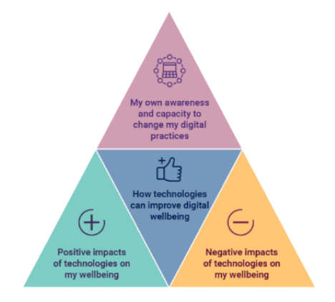
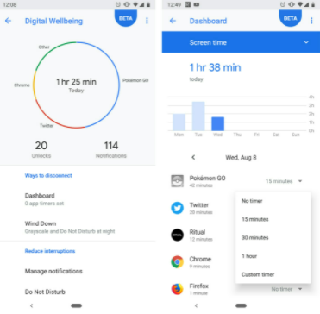
Tools for Effective Time Management
Digital Wellbeing

Slide 17
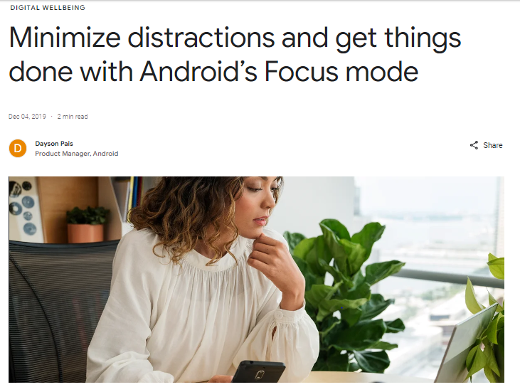
Tools for Effective Time Management
Digital Wellbeing

Slide 18
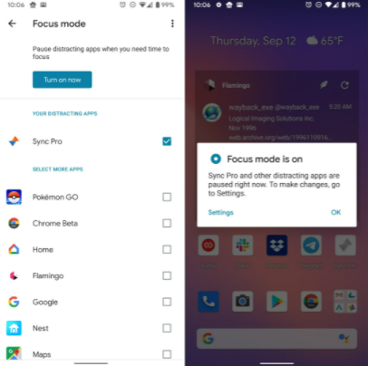
Tools for Effective Time Management
Digital Wellbeing

Slide 19
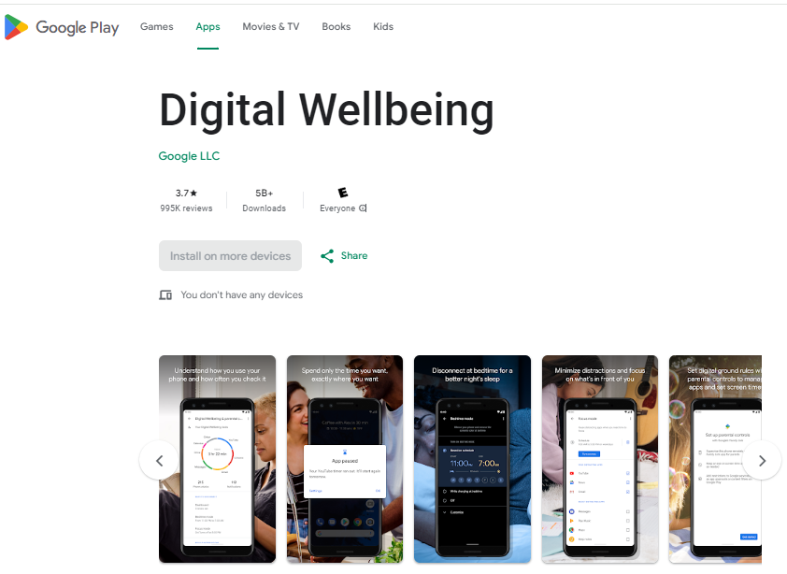
Tools for Effective Time Management (Play store)
Digital Wellbeing

Slide 20
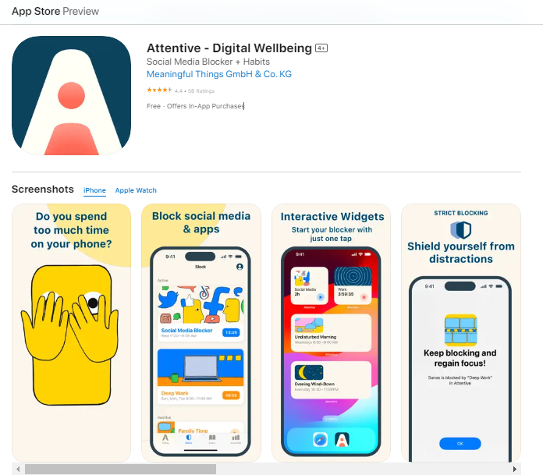
Tools for Effective Time Management (App store)
Digital Wellbeing

Slide 21
The bad news is time flies, The good news is you are the pilot -Michael Althsuler Thank You
Notes:
21

Slide 22
Questions ?

